Slide 1
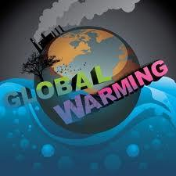
Global Warming
By: Matthew White, Emily Johnson, Star Stovall, and Josh Gilbert

Slide 2
What Is Global Warming?
Global Warming is the increase of Earth's average surface temperature due to effect of greenhouse gases.
Carbon dioxide emissions from burning fossil fuels or deforestation.
Traps heat that would normally be released from the Earth.

Slide 3
Ways To Fix It
Change a light- Replacing one regular light bulb with a compact fluorescent light bulb.
Drive less- Walk, bike, carpool or take mass transit more often.
Recycle more- You can save 2,400 pounds of carbon dioxide per year by recycling just half of your household waste.
Turn off electronic devices- Simply turning off your television, DVD player, stereo and computer when they are not being used.
Substituting Natural Gas for Coal- Natural gas as an energy source is a transition step on the road toward low-carbon energy from wind, solar and nuclear power.

Slide 4
Examples
Montana's Glacier National Park had 150 glaciers in 1910, it now has only 27 glaciers.
Average temperatures have climbed 1.4 degrees Fahrenheit since 1980.
Two-thirds of polar bears may be gone by 2050.
Oceans absorb CO2 which is mixed with seawater and turns to a weak carbonic acid.
Scientists believe sea levels will be three feet higher.

Slide 5
Examples Cont.
The Great Barrier Reef will disappear within decades.
More acidic seas could severely bleach coral in the world-famous reef as early as 2030.
A fifth of the wildflower species in the western United States could be wiped out.
Favorite foods (fast food/ healthy) will be be killed and not able to be regrown or made.
Diseases would be back into style from bugs. (ex: Mosquitoes)

Slide 6
Environmental Laws
Slow Down
The people are only to drive for a certain amount of hours.
Limit
The People are not allowed to use an extended amount of fossil fuels.
Electronics
If an electronic device is not in use, turn it off or unplug it from the source.
Recycle
Everyone is to recycle.

Slide 7
Connections To The Real World
Global warming is a problem in the real world, as well as in the Lorax.
The more smog we send into the air, the warmer our Earth will get.
The CO2 will eventually destroy our Ozone layer and end up destroying all types of populations.
People in society should stop creating so many factories that produce chemical pollution.
If global warming continues, the is a possibility that there will be a global flood.

Slide 8
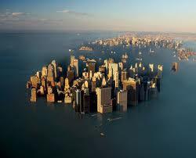
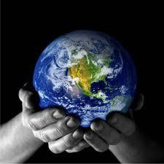
Make A Decision
OR

Slide 9
10 Sources
www.globalwarming.org/
www.epa.gov/airtrends/aqtrnd95/globwarm.htm
www.see-the-sea.org/
www.keepearth.keepbanderabeautiful.org/
www.forumforthefuture.org/
www.edf.org/climate
www.cotap.org/global-warming
http://topics.nytimes.com/top/news/science/topics/globalwarming/index.html
http://environment.nationalgeographic.com/environment/global-warming/
http://www.scientificamerican.com/topic.cfm?id=global-warming-and-climate-change

Slide 10
Global Warming Website
http://globalwarmingeducation.weebly.com/

